Slide 1
Unit 7: Read

Slide 2
Don’t go far
Shopping in comfort
Conveniences when buying in a shopping mall
Modern
Many at cheaper prices
Weather is no problem
a good selection

Slide 3
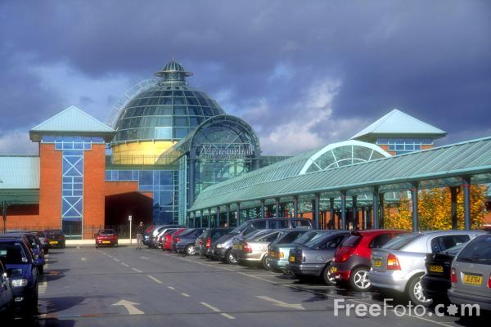

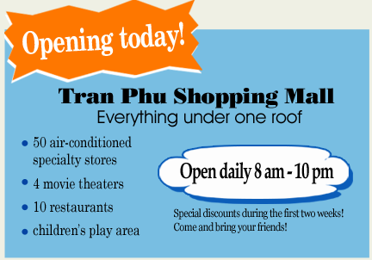
roofs
Tran Phu Shopping mall

Slide 4
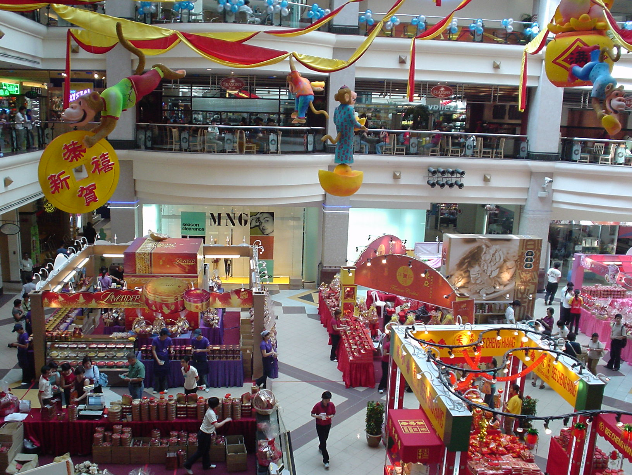
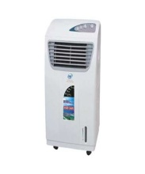
Children’s area
Movie theaters

Slide 5

Unit 7: My neighborhood - Read
A new shopping mall is opening in Nam’s neighborhood today. It is very different from the present shopping area. All the shops are under one roof. That will be very convenient, especially during the hot and humid summer months. Customers will shop in comfort and won’t notice the weather.
Some people in the neighborhood, however, are not happy about the changes. The owners of the small stores on Tran Phu Street think the mall will take their business. Some of the goods in the new stores will be the same as the ones in the small shops, but the stores in the mall will offer a wider selection of products, some at cheaper prices.
The residents and store owners have been concerned about the new mall for a few months. They have organized a community meeting in order to discuss the situation.

Slide 7
Unit 7: My neighborhood - Read
A new shopping mall is opening in Nam’s neighborhood today. It is very different from the present shopping area. All the shops are under one roof. That will be very convenient, especially during the hot and humid summer months. Customers will shop in comfort and won’t notice the weather.
Some people in the neighborhood, however, are not happy about the changes. The owners of the small stores on Tran Phu Street think the mall will take their business. Some of the goods in the new stores will be the same as the ones in the small shops, but the stores in the mall will offer a wider selection of products, some at cheaper prices.
The residents and store owners have been concerned about the new mall for a few months. They have organized a community meeting in order to discuss the situation.

Slide 8
1. True or False. Correct the false sentences.
T | F
a, The mall is open six days a week.
F
⇨The mall is open daily ( seven days a week)
b, There are more than 50 stores in the mall.
F
⇨ There are 50 stores in the mall.
c, Everyone in the neighborhood is pleased about the new mall.
F
⇨ Not every is pleased about the new mall.
d, It will be more comfortable to shop in the mall than in the present shopping area.
T
e, Some of the stores on Tran Phu Street may have to close.
T
Notes:
Unit 8. Read

Slide 9
2. Answer the following questions
a) What is special about the new shopping mall?
⇨ All the shops are under one roof and customers will shop in comfort.
b) What facilities are available in the shopping mall?
⇨ There are 50 air conditioned specialty stores, 4 movie theaters,
10 restaurants and a children’s play area.
c) What do the small store owners think about the shopping mall?
⇨ They think the mall will take their business.
d) What kinds of goods will the stores in the mall offer?
⇨ They will offer a wider selection of products.

Slide 10




Who's a milionaire?
A new……..is opening in Nam’s neighborhood today
50:50
A. shop
A. shopping mall
B. shopping mall
C. restaurant
D. market

Slide 11
Who's a milionaire?
Shopping is very………during the hot and humid weather.
50:50
A. expensive
B. cheap
C. tired
D. convenient
D. convenient

Slide 12
Who's a milionaire?
The owners of the small stores think the mall will take their…….
50:50
A. money
B. products
C. business
C. business
D. goods

Slide 13
Who's a milionaire?
The stores in the mall will offer a ……..of products.
50:50
A. little selection
B. wider selection
B. wider selection
C. smaller selection
D. many selections

Slide 14
Who's a milionaire?
Store owners have been ……..about the new mall for a few months.
50:50
A. concerned
A. concerned
B. happy
C. interested
D. comfortable

Slide 15
Who's a milionaire?
………will shop in comfort and won’t notice the weather.
50:50
A. workers
B. doctors
C. customers
C. customers
D. teachers

Slide 16
Use the words given to complete the gaps.
humid
about
happy
discuss
mall
roof
because
Today a new shopping mall is opening in Nam’s neighborhood. All the shops are under one (0)………and very convenient when shopping especially during the hot and (1)………weather.
Some people are not (2)………. about the changes. They think the (3)……….will take their business (4)……….. the mall offers a wider selection of products. Some at cheaper prices.
The store owners have been concerned (5)……..the mall for some months. They have organized a community meeting to (6)……... the situation.

